Slide 1

Intro to Practical development
Making things with raspberry Pi and Python!

Slide 2
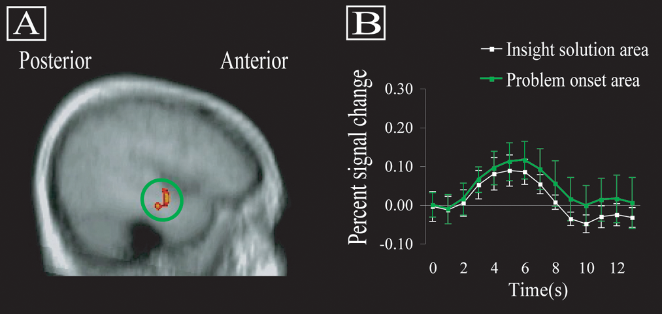
Practical Development

Slide 3



What *are* we doing?
Building
Developing
Testing
Making! Hacking! Developing!

Slide 4
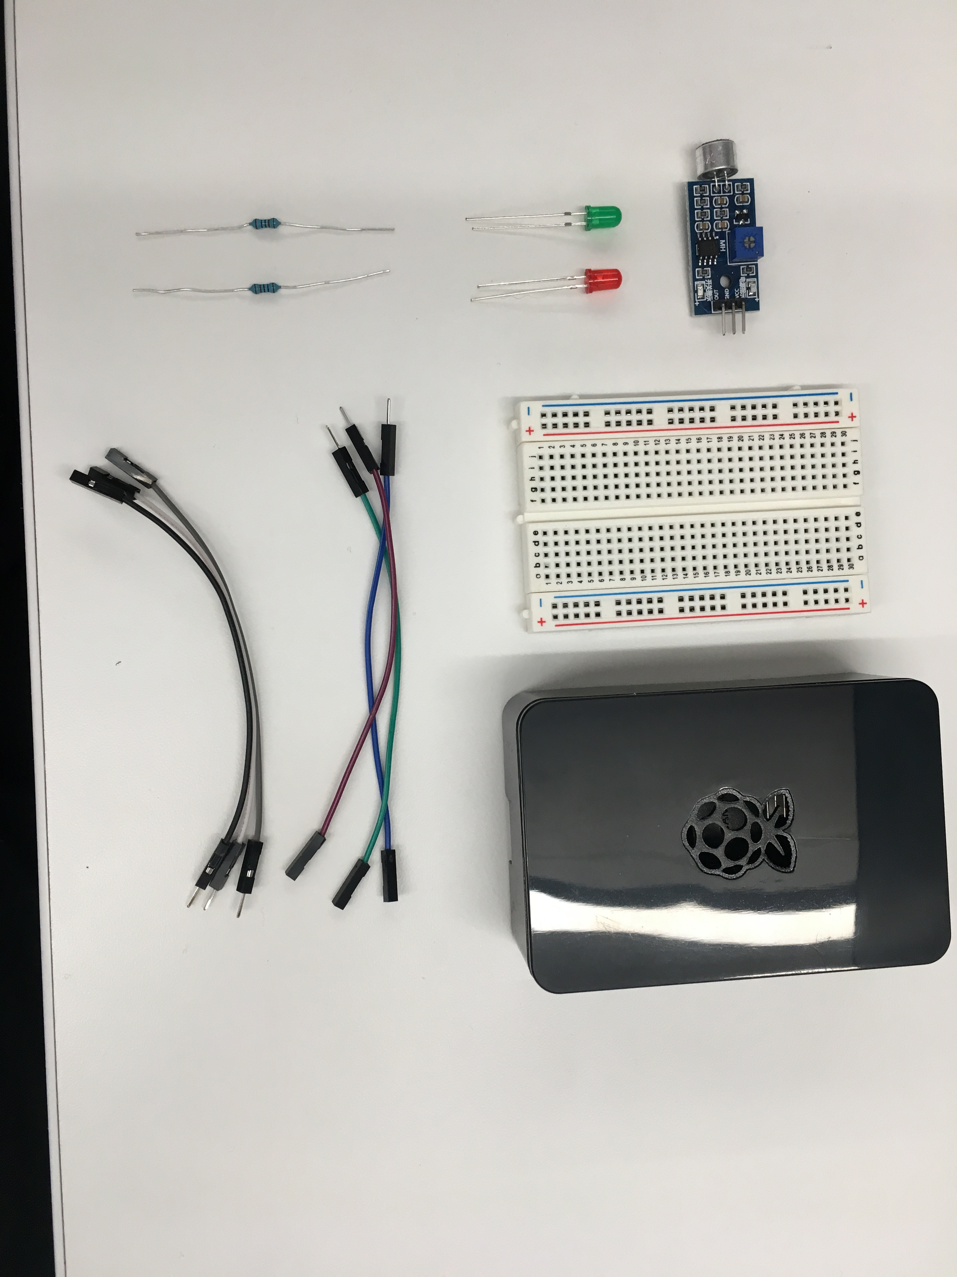
Hardware – AKA What’s in the box
Basic hardware required to build our project
Breadboard
Wires
Lights
Resistors
Sensor
Raspberry Pi 3

Slide 5
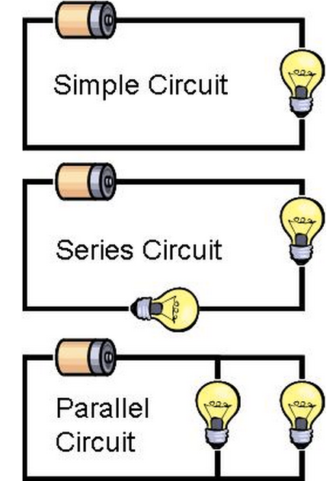
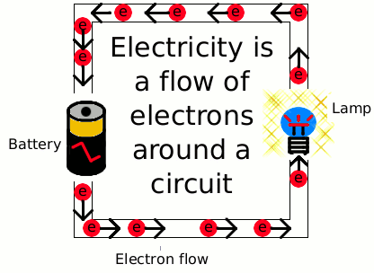
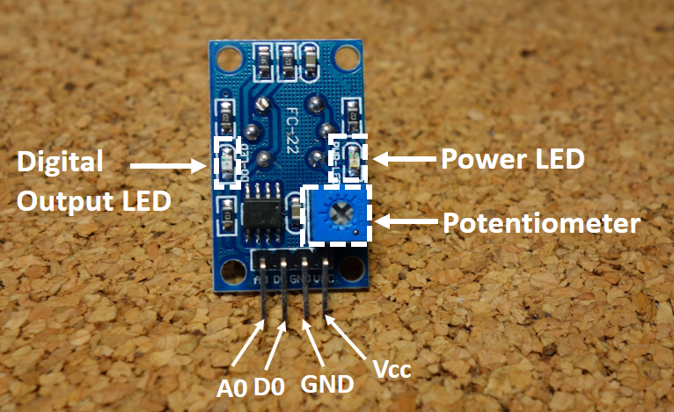
Hardware fundamentals
HW is all about Flow Control
We will build a circuit (3 of them)
Common Sensor pinout
VCC = power IN
GND = power OUT (Ground)
A0 = Analog output
D0 = Digital output

Slide 6
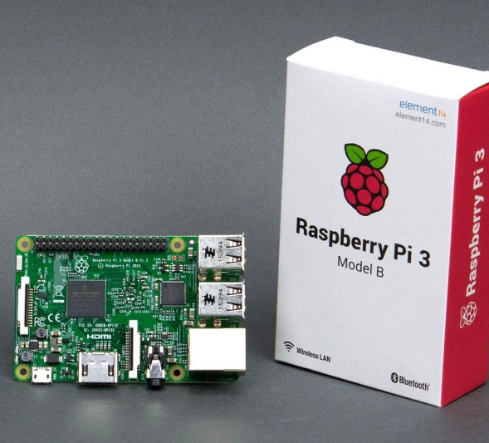
Raspberry Pi
Why Pi for IoT?
Cost
Accessibility
Community
Peripherals
First to market
Small, light, and “good enough”

Slide 7
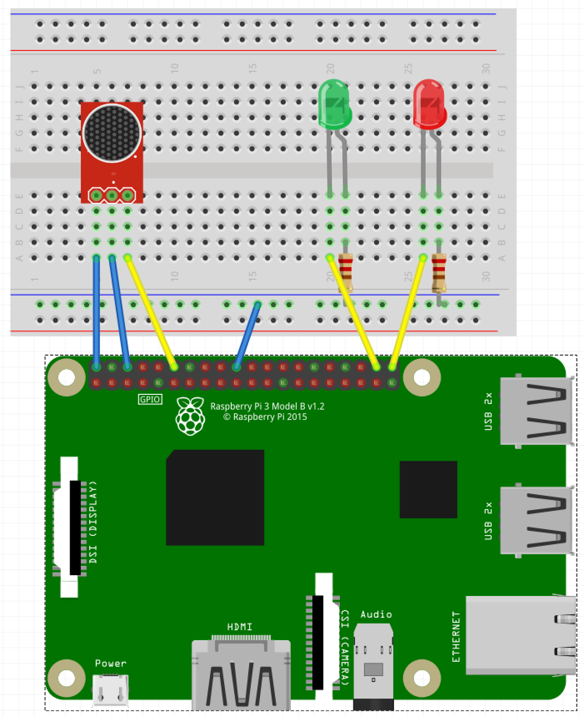
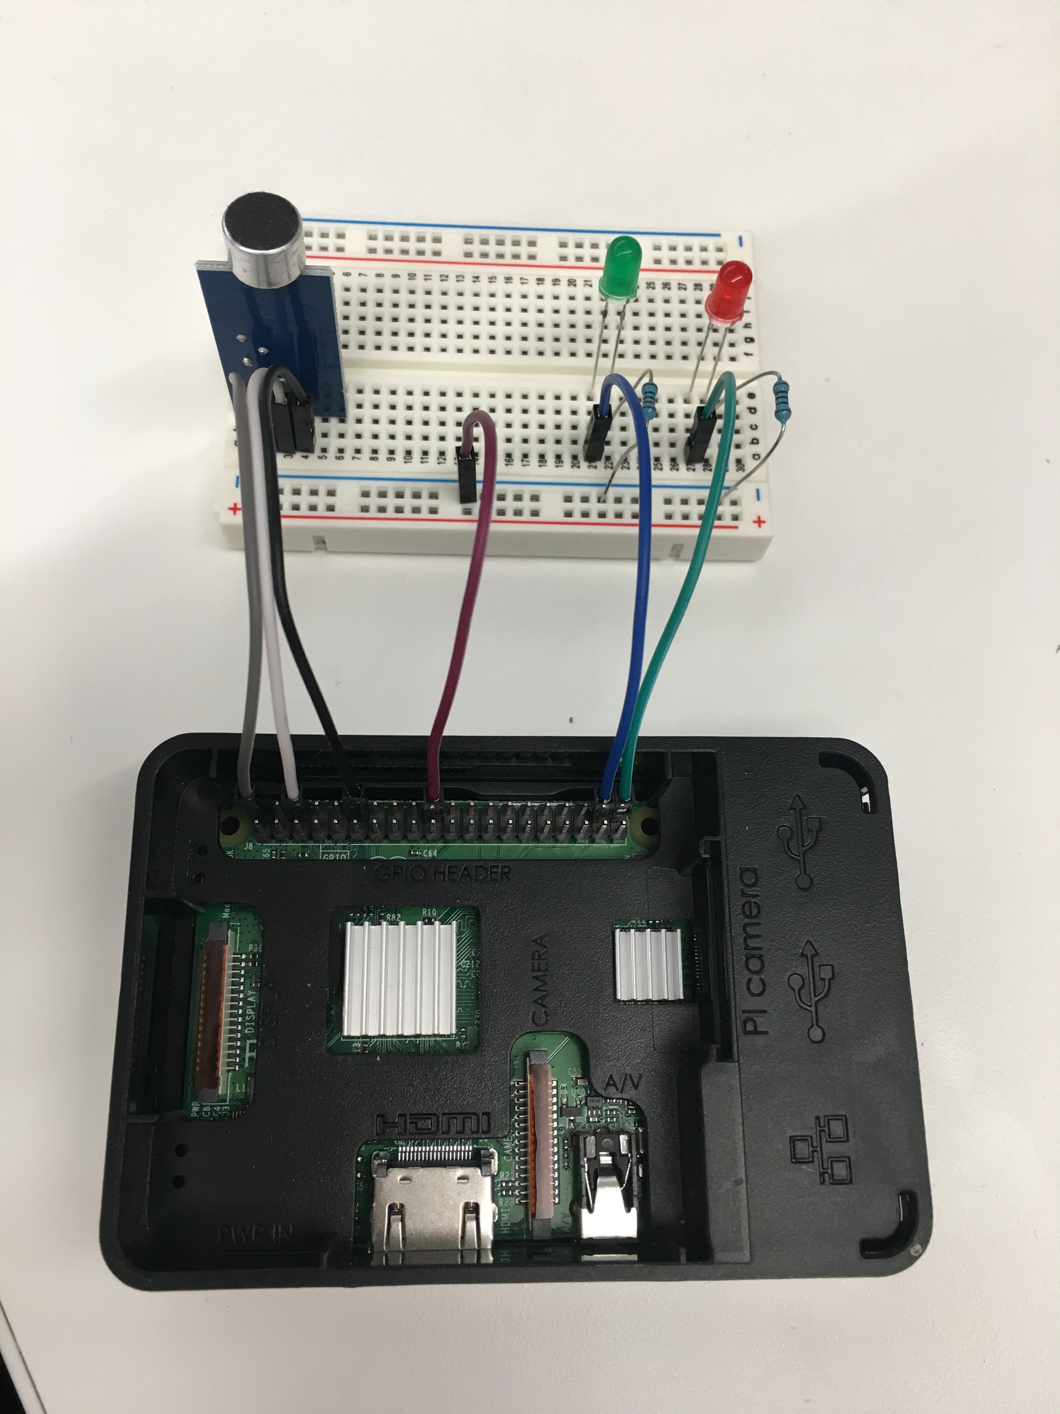
Slapping it all together
What the finished product looks like
Interpreting a diagram versus a picture
Simple is better in prototyping

Slide 8
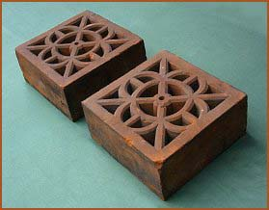
Now we have a Fancy Brick
It looks cool!
It matches the picture
It doesn’t do anything
Yet!

Slide 9
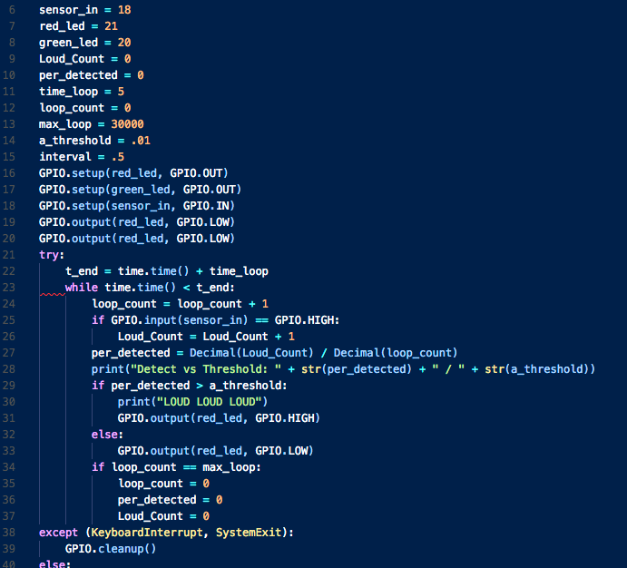
software
Variables
Functions
Inputs
Outputs

Slide 10
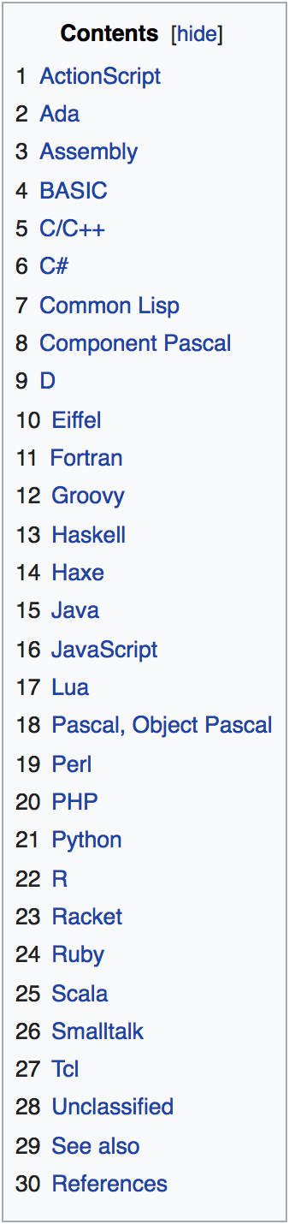

Code power!
How do we “build” software?
What are the resources you need?
Keeping track of code?

Slide 11
Getting started with writing code
A development tool
A place to save code
Access to other libraries and info

Slide 12
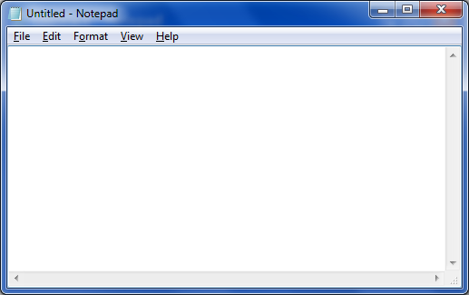
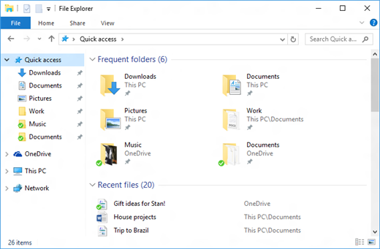










Slide 13

What’s next?

Slide 14
Some resources for you And a Favor for me
Official Resources:
Raspberypi.org
Python.org
Other Resources:
Youtube! Instructables! Amazon!
Github.com/ChrisHarrold
@charrold303 @codecoffeeyvr
A Favor:
http://bit.ly/charrold

Slide 15

Congratulations!
You’re officially an IoT Developer! Don’t forget your Sticker!!

